Slide 1
How to regrid a staggered vector field on a structured grid
Alexander Pletzer Dec 23 2016/25 May 2017
New Zealand eScience Infrastructure (NeSI) and National Institute for Water and Atmospheric (NIWA) research
Motivated by one of the questions asked during ESMF presentation 13 Dec 2016:
“Vector regridding: Will there be an algorithm to regrid vectors (winds), say, from lat-lon to cube-sphere? It involves rotation of vectors.”

Slide 2
Vector fields with staggered components
Examples:
Face centred (red)
Edge centred (green)
Questions:
F = Σ w_{i} F_{i} or Σ w_{i} F_{i}?
w_{i} is weight, F_{i} is field value on face or edge
Vector weights (basis functions) or vector values?
If using values, what components should we use?
Cartesian x, y, z?
Aligned to latitudes and longitudes?
How do the components change under coordinate transformations? Rotated pole?
What happen if the coordinates are locally non-orthogonal?
What happens to partially valid cells?

Slide 3
Example of non-orthogonal cell: corner of a cubed sphere grid
Not clear how to attach vector components to the faces?
120 deg

Slide 4
Proposed solution for face centred field
Attach flux integral values to each face of the cell
Target is a surface (not a point!). Identify the part of the target inside a cell
Interpolation weight = surface integral of vector basis function over the target
Add the contributions from all the faces

Slide 5
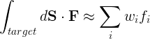
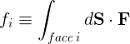
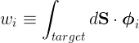
Mathematically speaking…
Flux interpolation on target surface
(defines interpolation)
Flux on face i
is given
Interpolation weight
needs to be computed
for each target
Vector basis function on face i

Slide 6
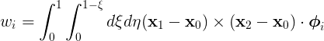
For a triangular target…
2
Use parametric representation of triangle
Weight then becomes
0
1
Still need to define the basis function

Slide 7
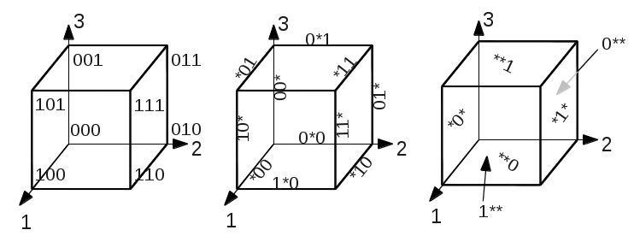
First: identify faces, edges, etc, forming a cell
So we can iterate over faces, edges etc.
Identify nodes, edges, faces and cell with with triplet in range {0, 1, *}
Node triplets have no *, edges have 1 *, faces have 2 *’s , cell has ***
Nodes
Edges
Faces

Slide 8
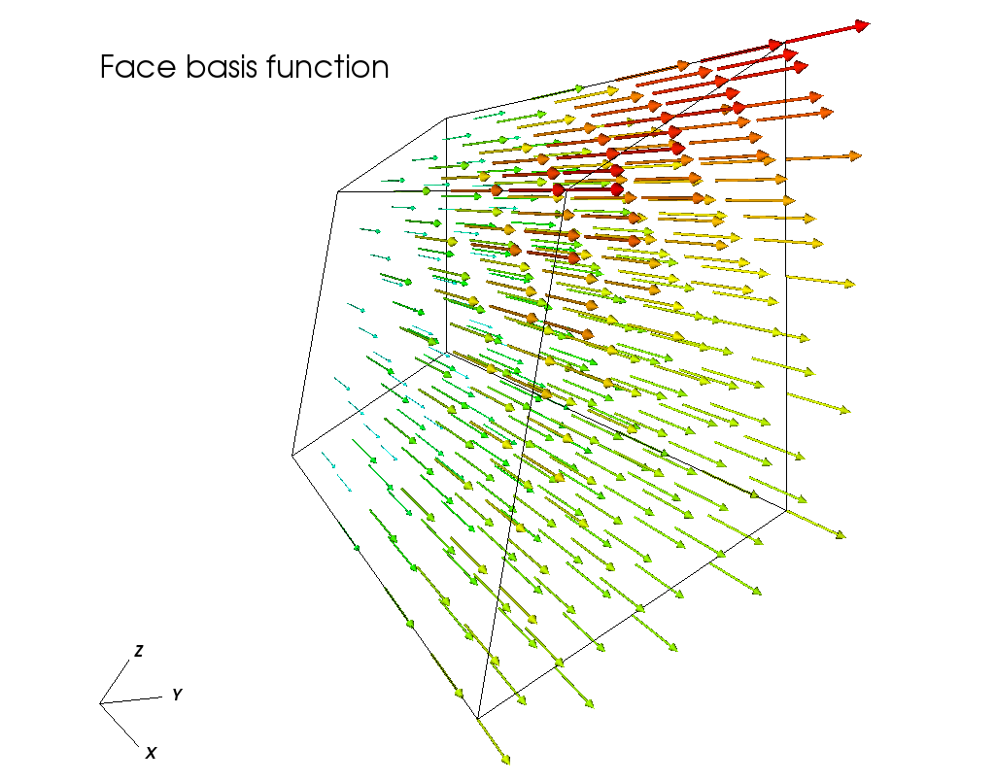
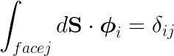
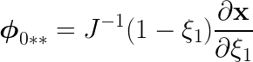
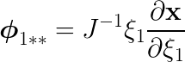
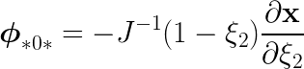
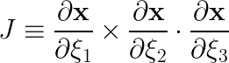
Second: look for basis functions that satisfy orthogonality condition
3
A possibility is:
Index 1
1
2
φ
*1*
Cell volume

Slide 9
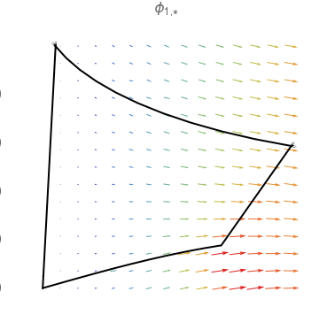
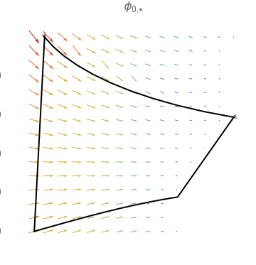
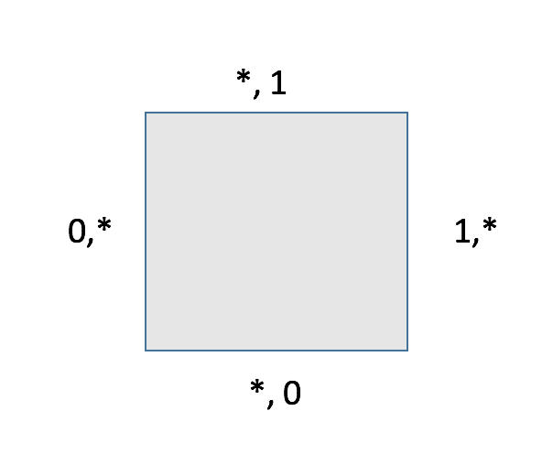
The 2D face vector basis functions
Supporting face
Vector field is no longer perpendicular to the face for curvilinear cells. Instead it is tangential to adjacent faces.

Slide 10
Application 1: Divergence-free flow
Flux integral is “exact” if start and end points are on cell faces
Loop integral yields zero to machine accuracy

Slide 11
Application 2: Handling grid singularity
1/r singular field
Divergence is zero except at singularity
No need to punch hole at (0, 0)
Red gives 1
Blue gives 0

Slide 12
Bilinear won’t work on vector field
Residual error depends on
grid resolution
Adding more segments
no longer helps

Slide 13
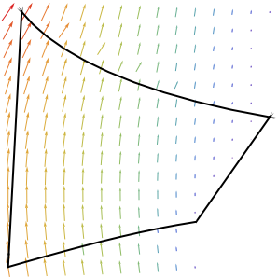
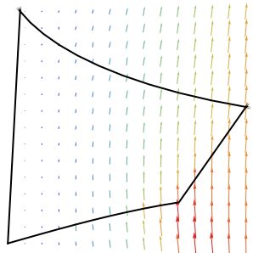
Kill two birds with one stone
Edge basis functions in 2D, perpendicular to adjacent edges
Weights are the same as for face basis functions!

Slide 14
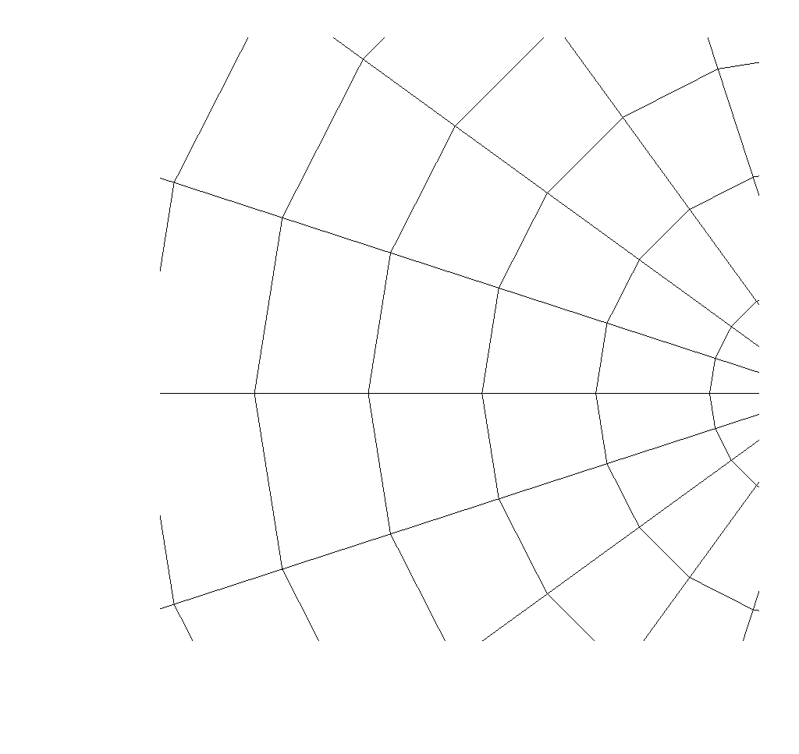
Proposed implementation in ESMF
Tackle 2D first
Find all the intersection points between the target (polyline) and the grid
Attach sub-segments to cells
For each sub-segment compute the interpolation weights from the cell edges
Add the contributions from each sub-segment
Exact integrals for each cell

Slide 15
Proposed API
ESMF.api.regrid.Regrid(srcField, dstField, src_frac_field, dst_frac_field, method=EDGE2D, …)
Structured or unstructured grid support initially?
Hard to know what the number of edges will be for unstructured
Getting unstructured underneath, API exposes structured initially
To go fully unstructured, would need to be able to apply edge/face fields to unstructured
SGRID standard, staggered grid convention (need to check if structured or based on UGRID?). https://github.com/sgrid/sgrid
2D or 3D?
Likely 2d initially
3D later

Slide 16
Summary
Target is a surface element for a face centred field, a line element for a edge field… In 2D edge/face interpolation is the same.
Only compute things that are invariant with respect to coordinate transformations (ie scalars).
Ask the user to provide scale invariant fluxes and attach these to cell faces. (Can do if user provides vector fields and face elements.)
For partially valid cells, user should provide fluxes reduced by the amount of invalid face area. No further action is required (ie no need for masking, partial face ratios, etc). Fractional fields coefficients would also work.

